Slide 1







Searching and browsing TED Talks like you never imagined
José Luis Redondo García – redondo@eurecom.fr
GO!
@peputo
Raphaël Troncy –raphael.troncy@eurecom.fr
@rtroncy
Mariella Sabatino –mariella.sabatino@eurecom.fr
@marSabs
Pasquale Lisena – pasquale.lisena@eurecom.fr
@PasqLisena

Slide 2
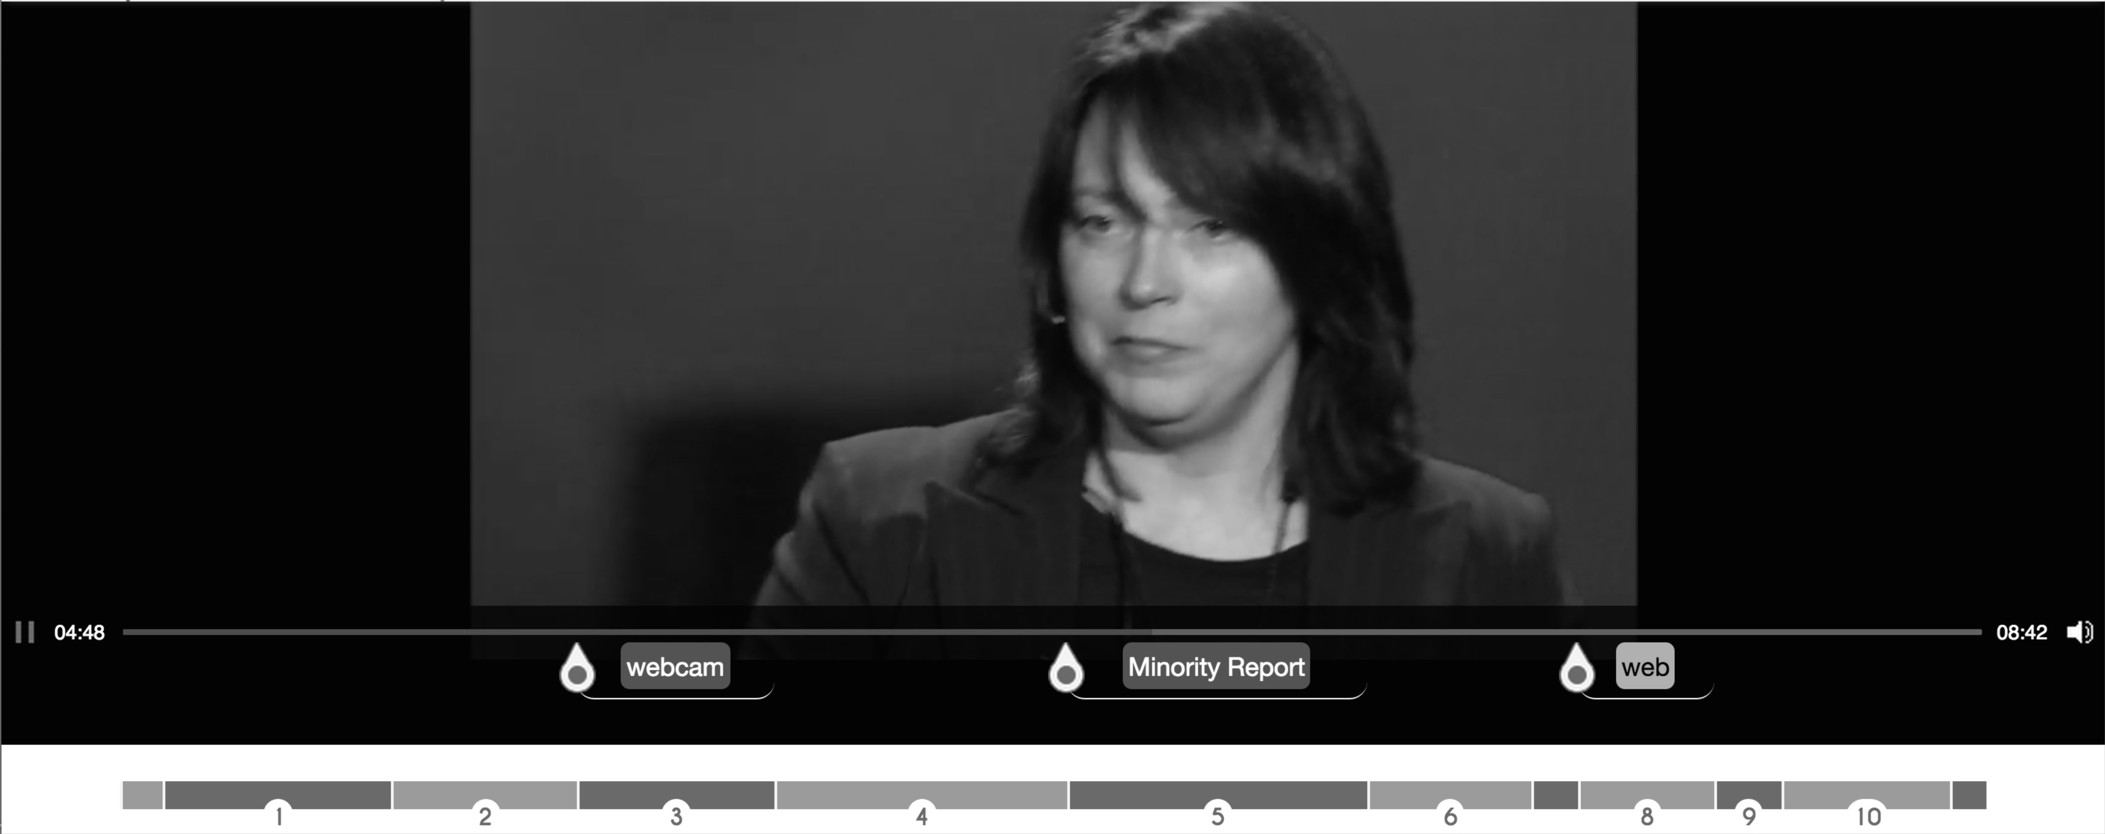
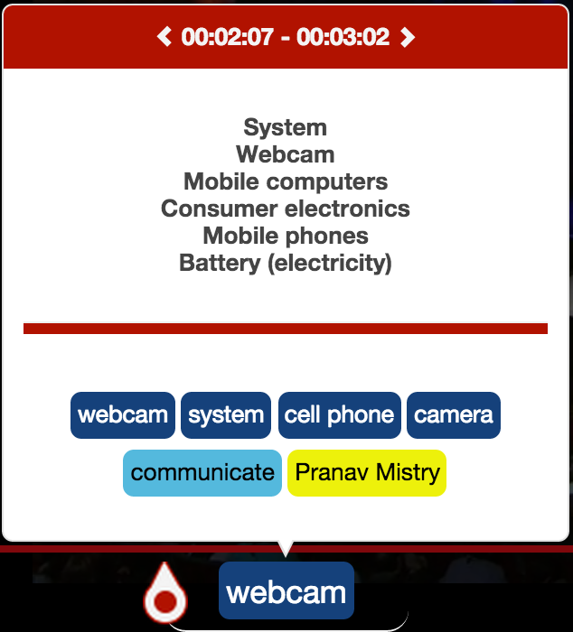
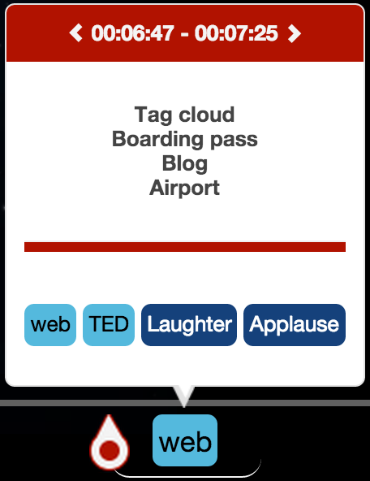



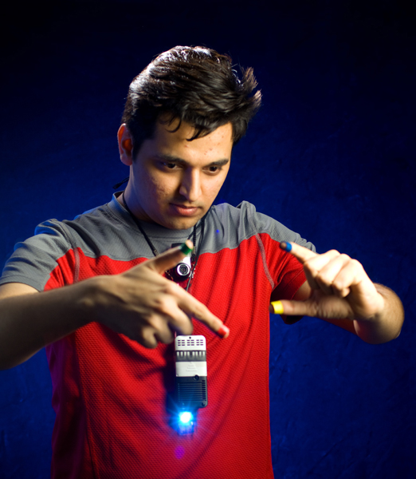
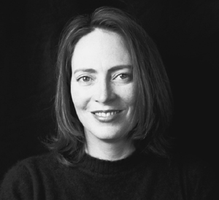


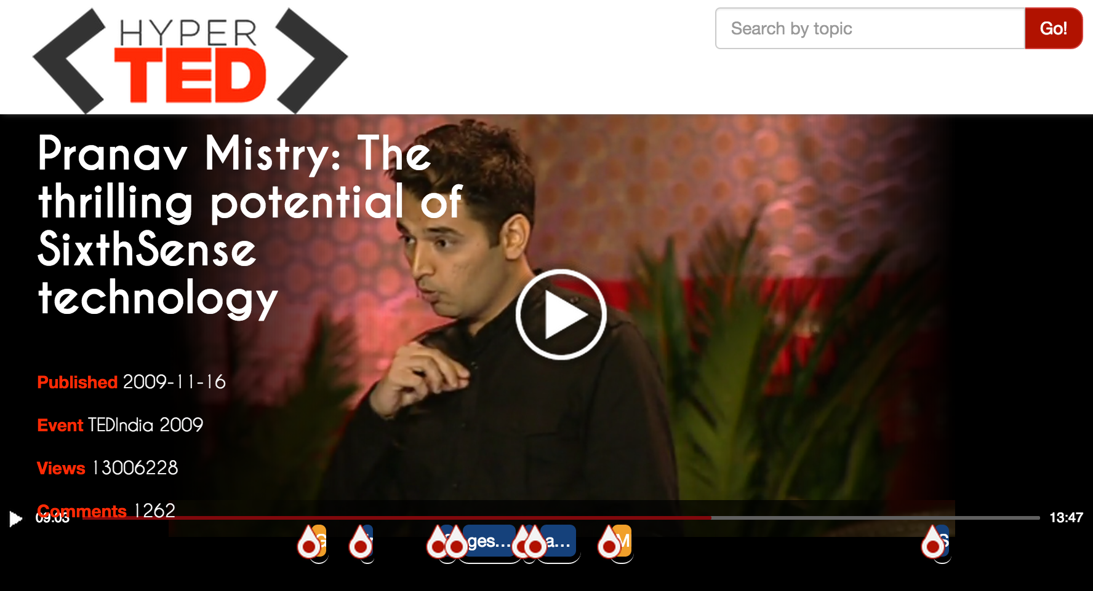

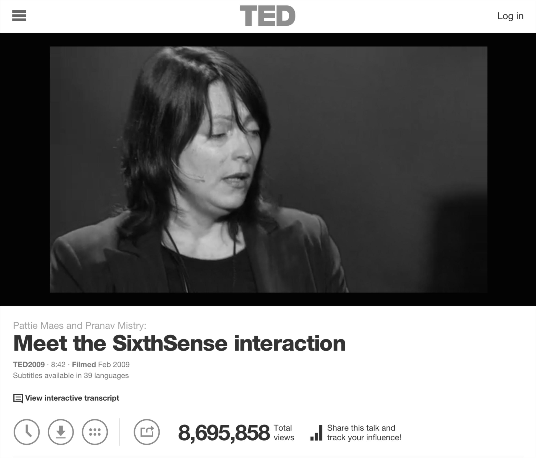



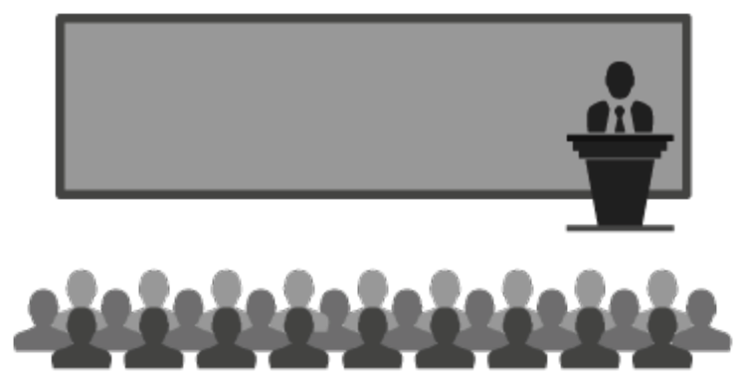
2014
Hot spots
Chapters
Entities
Related Ted’s Chapters
2006
.com
Courses
1984
Understanding environment:
A system approach
The Mysterious Field of Engineering Systems
Systems practice: Managing sustainability

Slide 3
New Consuming Paradigm
Can the video be divided into meaningful fragments?
How can those fragments be properly described?
Users overwhelmed with audio-visual content
How can users easily find related documents which complement the video
What are the potentially relevant fragments ?

Slide 4
HyperTED
Media Fragment support
Chapters
Hot Spots
MF Annotations
Named Entity Extraction
Topic Detection
Hyperlinking
Other TED talks chapters
Educational online resources

Slide 5
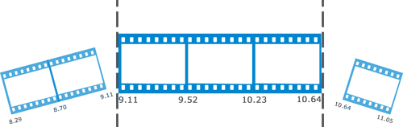
Media Fragments
A Media Fragment is a portion of a multimedia resource.
Temporal Fragments
sections along the time dimension of the media resource with a start and an end point.
http://www.w3.org/TR/media-frags/
http://www.w3.org/TR/media-frags/

Slide 6
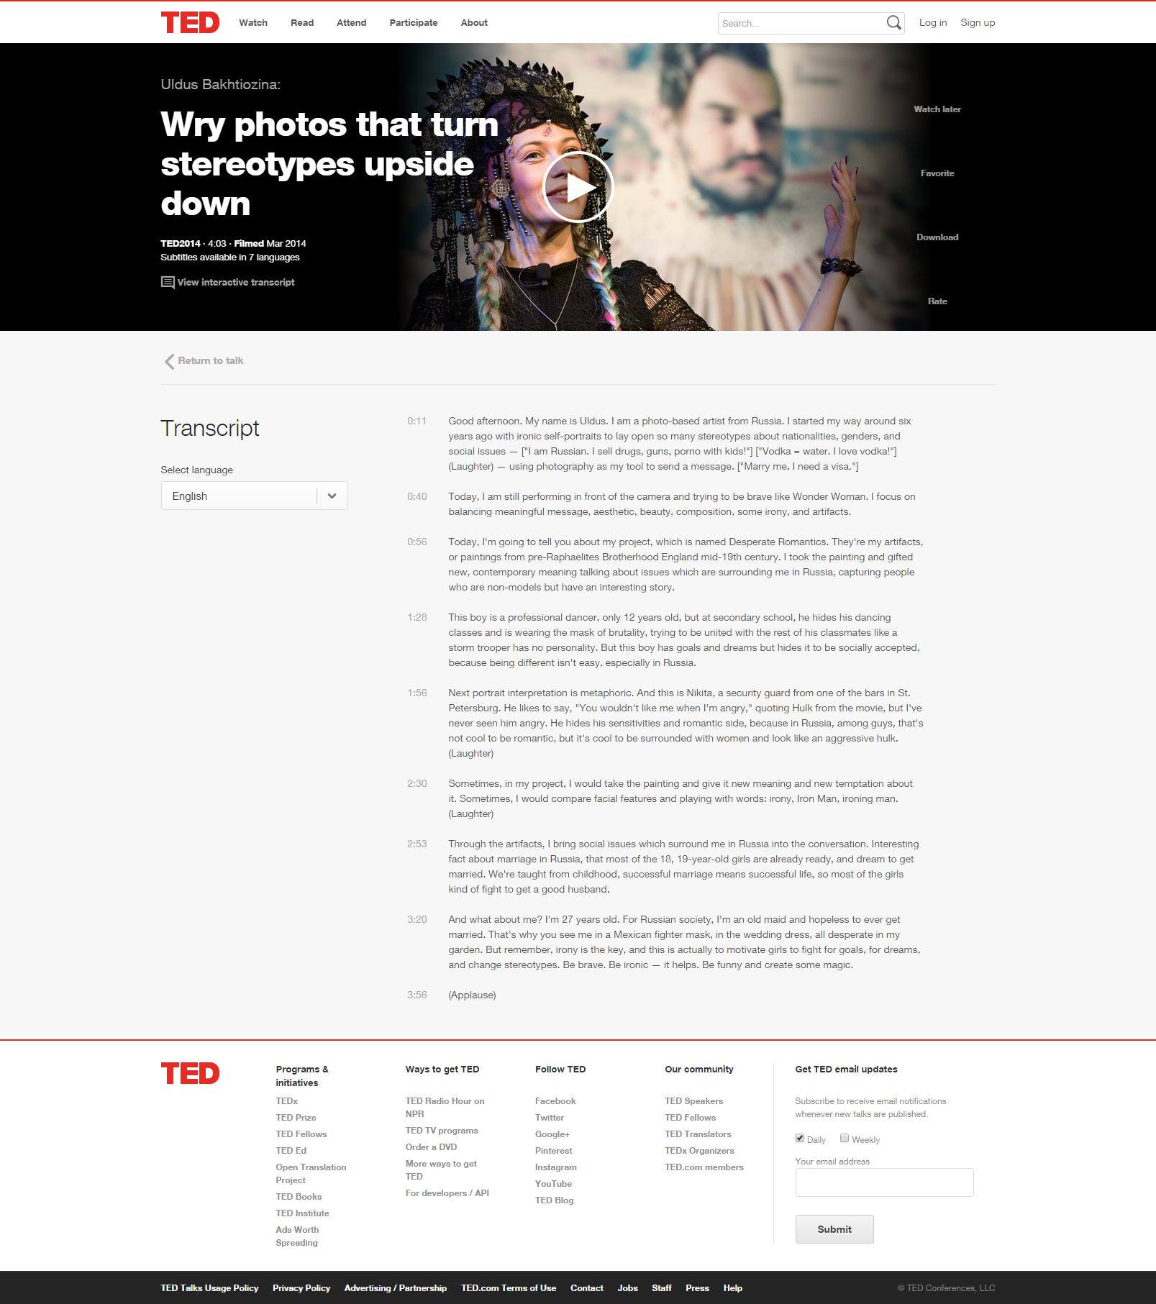
MF: Chapters
TED Talks have paragraphs:
a human-made subdivision of subtitles.

Slide 7
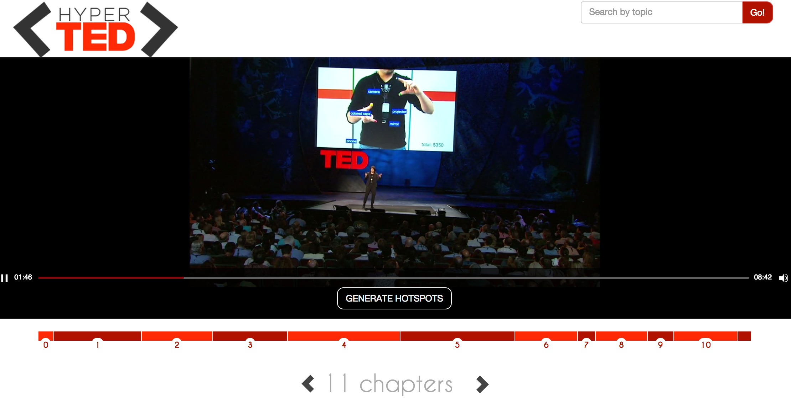
MF: Chapters

Slide 8
Annotations: Named Entities
“This is Nikita, a security guard from one of the bars in St. Petersburg.”
NER
“This is Nikita, a security guard from one of the bars in St. Petersburg.”
PERSON
Natural Language Processing (NPL) Task → disambiguating URL in a knowledge base.
E.g. http://dbpedia.org/resource/Saint_Petersburg.
Category:
type in the NER task.
FUNCTION
LOCATION
Example taken from the transcript of
https://www.ted.com/talks/2089

Slide 9











NER Extractors
Integrates different NER tools available on Web.
Unify NER extractors in a common output.

Slide 10
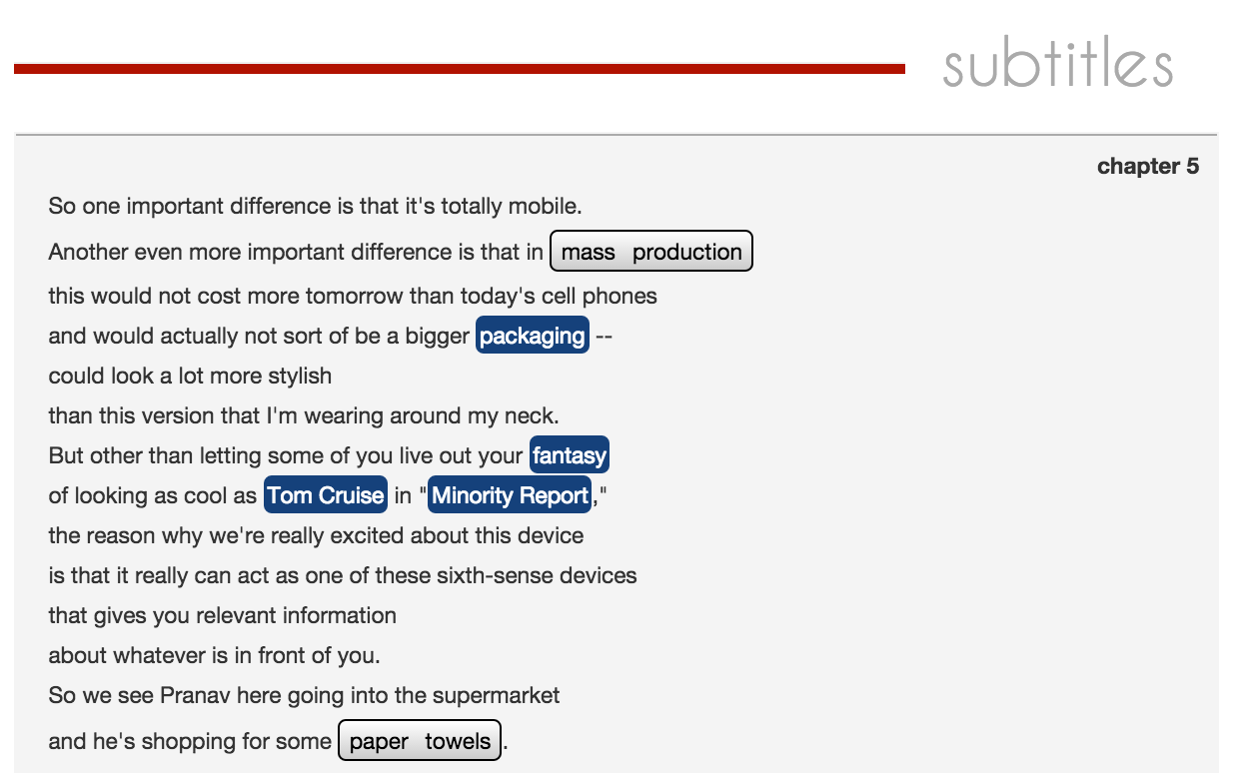
Annotations: Named Entities

Slide 11
Annotations: Topics
Chapter 3
“I'm wearing a camera, just a simple webcam, a portable, battery-powered projection system with a little mirror. These components communicate to my cell phone in my pocket which acts as the communication and computation device. And in the video here we see my student Pranav Mistry, who's really the genius who's been implementing and designing this whole system...”
Consumer electronics
Battery (electricity)
Mobile computers
Example taken from the transcript of
https://www.ted.com/talks/pattie_maes_demos_the_sixth_sense

Slide 12
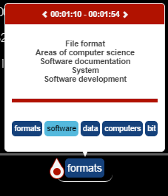
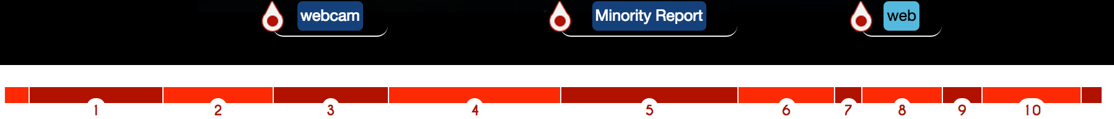
MF: Hot Spots
Hot Spot 2
Clustering of consecutive Chapters which talk about similar topics and Entities
Ordering of those fragments based on annotation relevance (TF-IDF)
Filtering: The Hot Spots are fragments whose relative relevance falls under the first quarter of the final score distribution.
Hot Spot 1
Hot Spots
Chapters

Slide 13
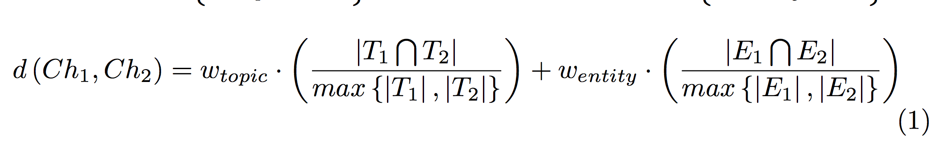
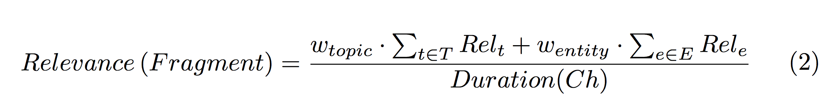
MF: Hot Spots
Clustering of consecutive Chapters which talk about similar topics and Entities
Ordering of those fragments based on annotation relevance (TF-IDF)
Filtering: fragments whose relative relevance falls under the first quarter

Slide 14
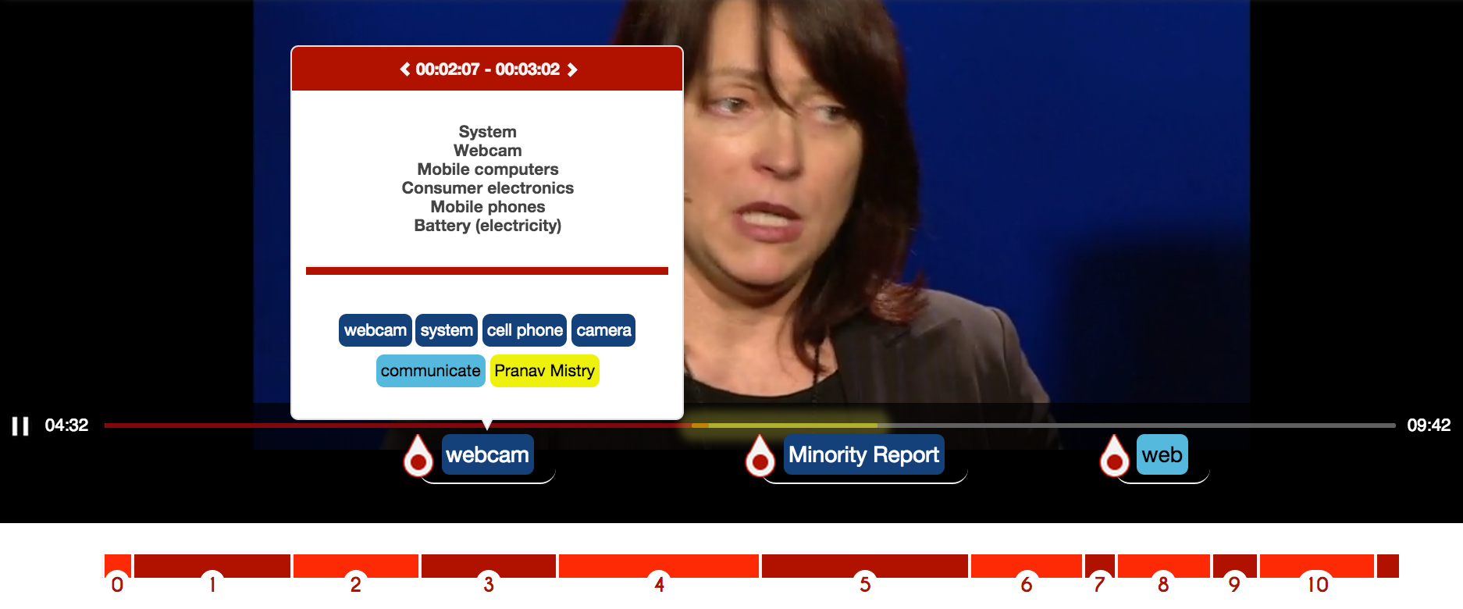
MF: Hot Spots

Slide 15

Hyperlink: Indexing TED Talks
Granularity level:
Chapter
Features Indexed :
Topics
Entities
timing references (startNPT and endNPT)
Extractor confidence
Resource Identifier
Full text transcript

Slide 16
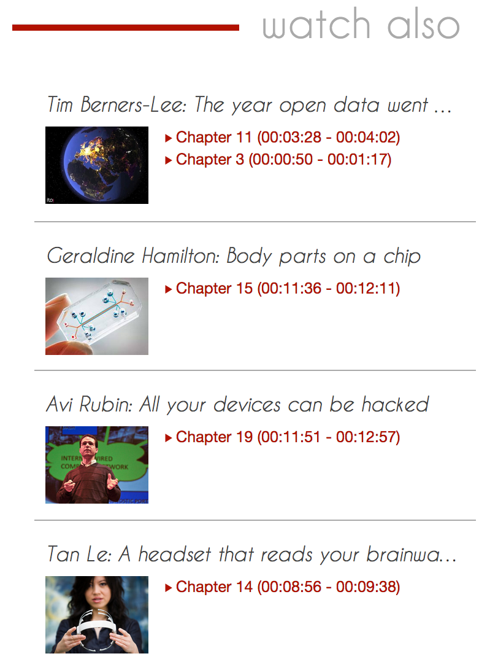
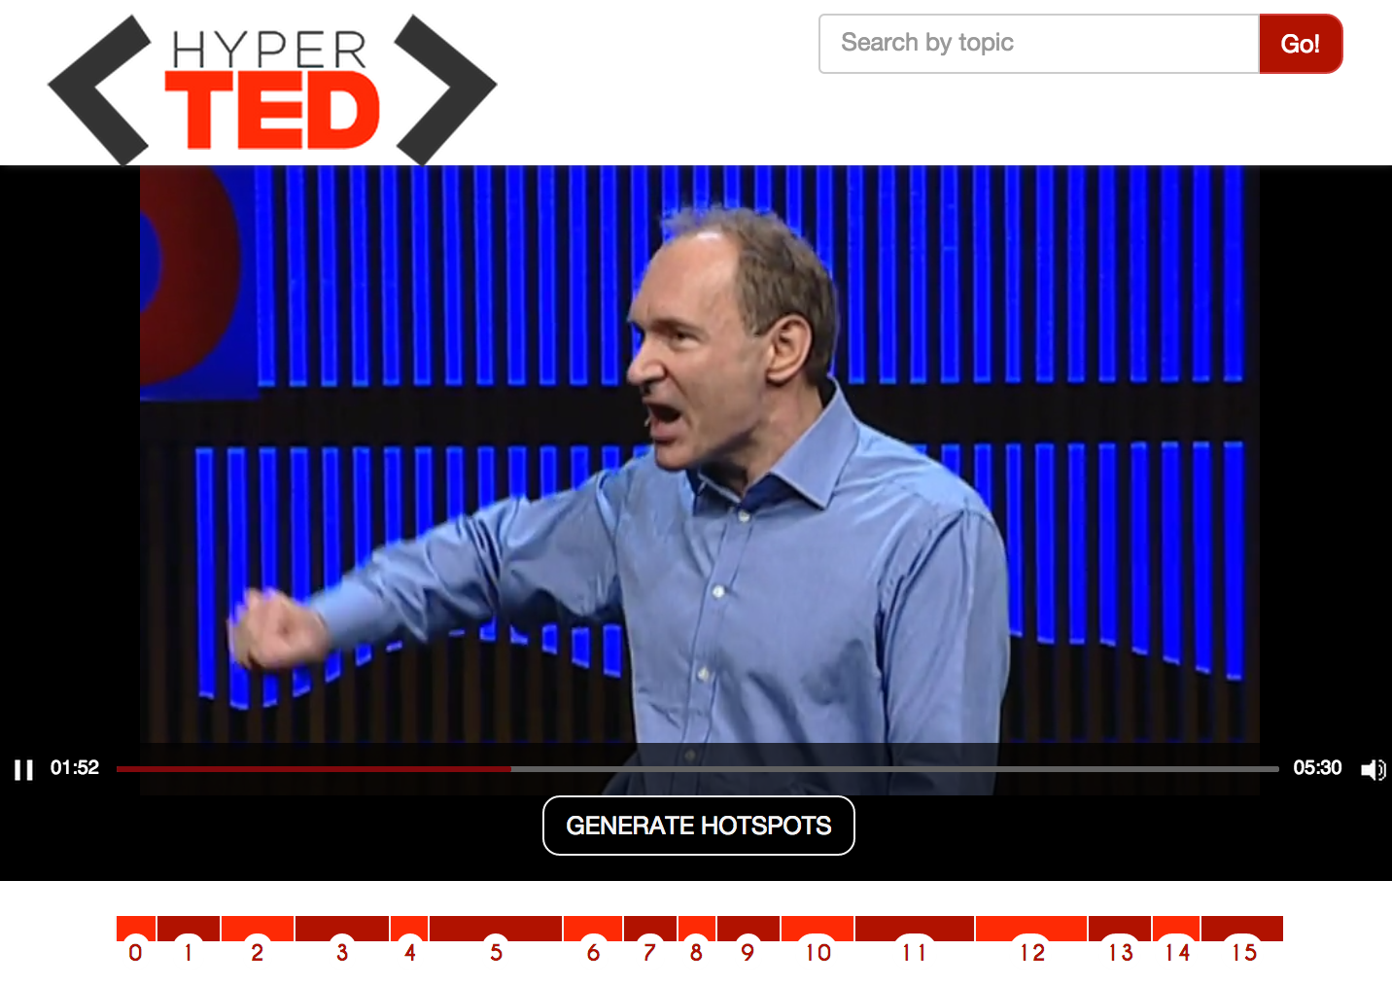
Hyperlink: Indexing TED Talks

Slide 17
Hyperlink: Finding related Courses
Datasets :
Open Courseware
Open University
Anchors used in search:
Entities Too specific.
Topics Courses about the same thematic
Attributes used in search:
Title
Description
Subject, thematic…
SPARQL is not a IR Language

Slide 18
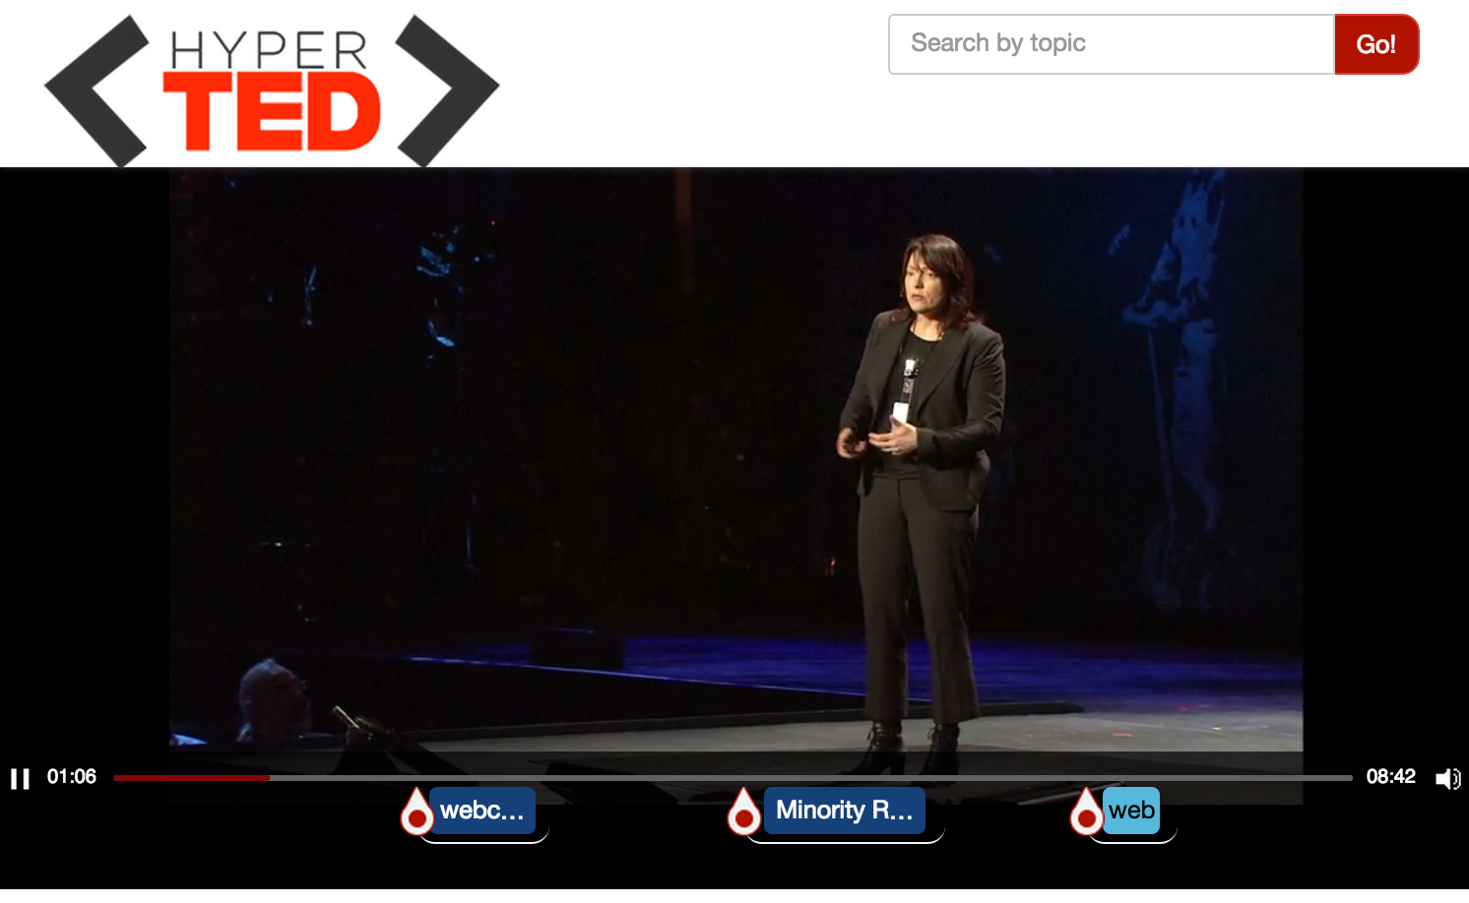
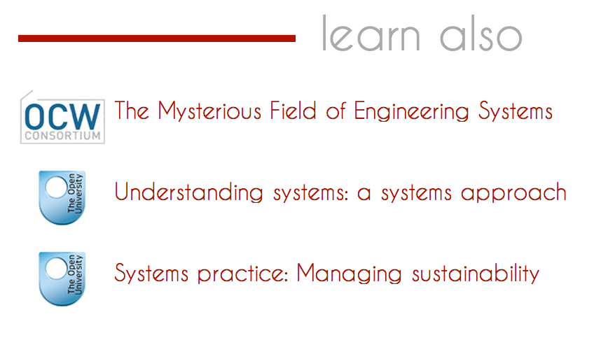
Hyperlink: Finding related Courses

Slide 19
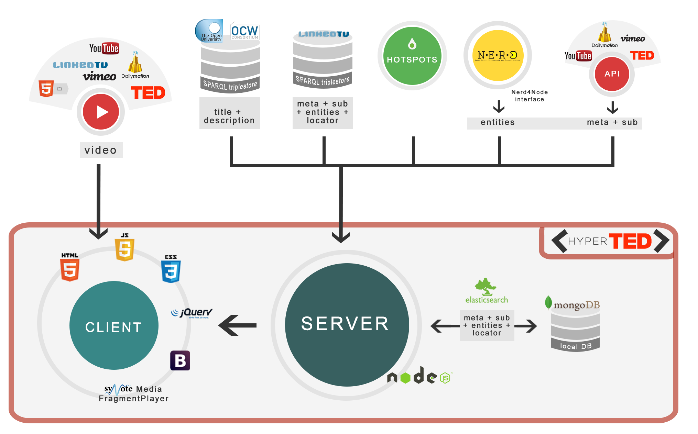
Architecture

Slide 20
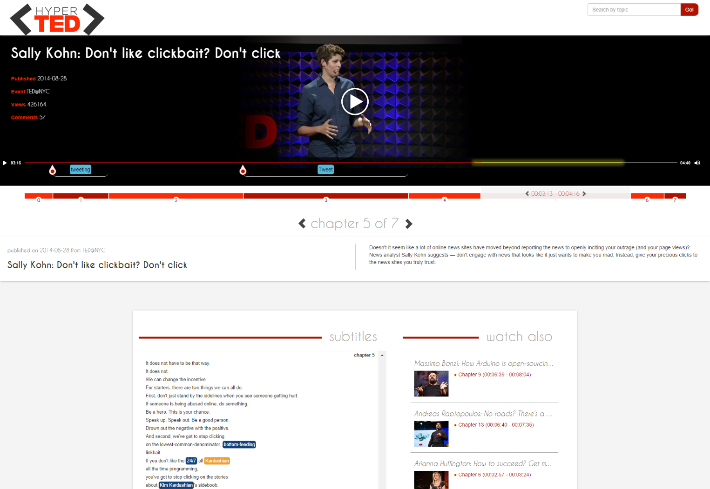
DEMO time
http://linkedtv.eurecom.fr/mediafragmentplayer

Slide 21
Conclusions
Media Fragment player: annotated fragments
Hot Spots detection based on topics and entities
Hyperlinking between chapters of TED talks + external education resources
Responsive and Web compliant UI
Future: formal evaluation of suggested content, better SPARQL queries and content indexing

Slide 22
Thank you!
Code: https://github.com/jluisred/HotSpots https://github.com/pasqLisena/MediaFragPlayerDemo
José Luis Redondo García – redondo@eurecom.fr
GO!
@peputo
Raphaël Troncy –raphael.troncy@eurecom.fr
@rtroncy
Mariella Sabatino –mariella.sabatino@eurecom.fr
@marSabs
Pasquale Lisena – pasquale.lisena@eurecom.fr
@PasqLisena

